Slide 1
Model Result – 6 Var input

Slide 2
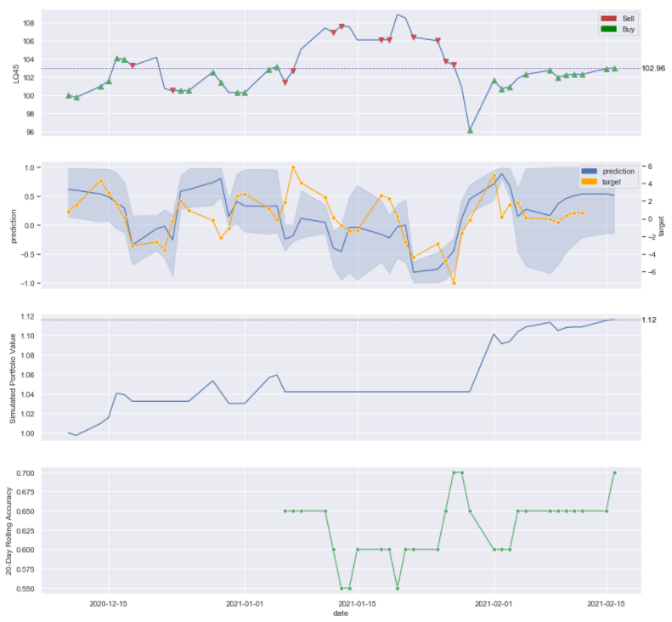

2 Month Simulation – newer_data model

Slide 3
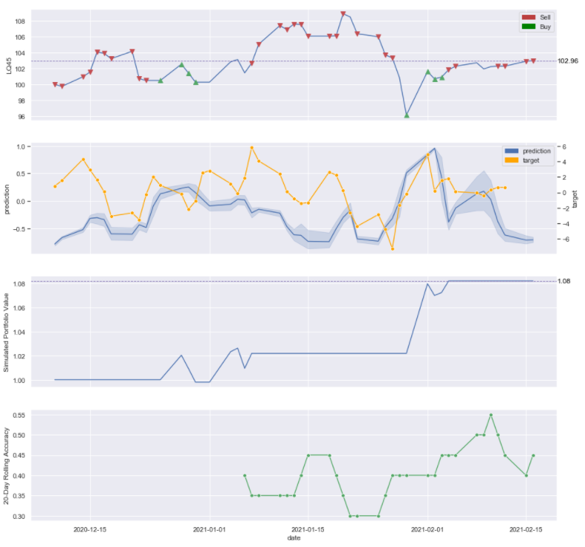

2 Month Simulation - high_acc model

Slide 4
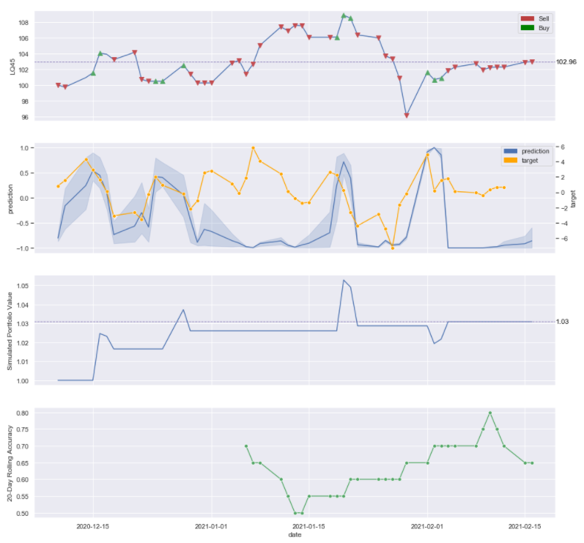

2 Month Simulation – six_var model

